Slide 1
Human Factors Engineering (HFE)
Applications in Medical Device Design
Alex Ngan ‘21

Slide 2




About Me
Dual Major: Design, Innovation, and Society, B.S. & Communication, B.S.
Class of 2021
Started as DIS & MechE
Current role as an R&D Usability Engineer within ZOLL Medical’s Acute Care Technology (ACT) division. Previously worked at DePuy Synthes (J&J) on orthopedic implants/surgical equipment.

Slide 3
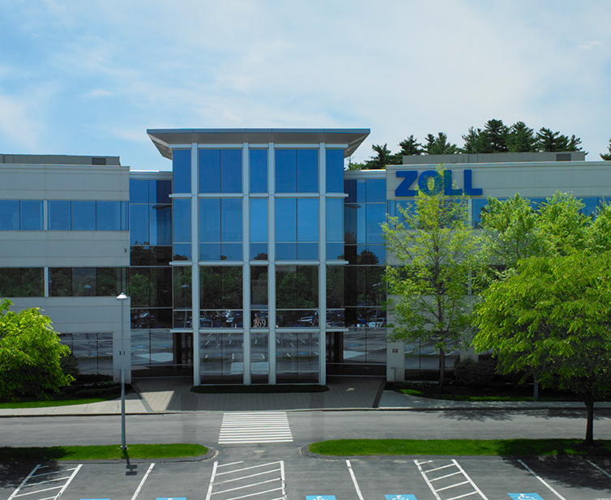
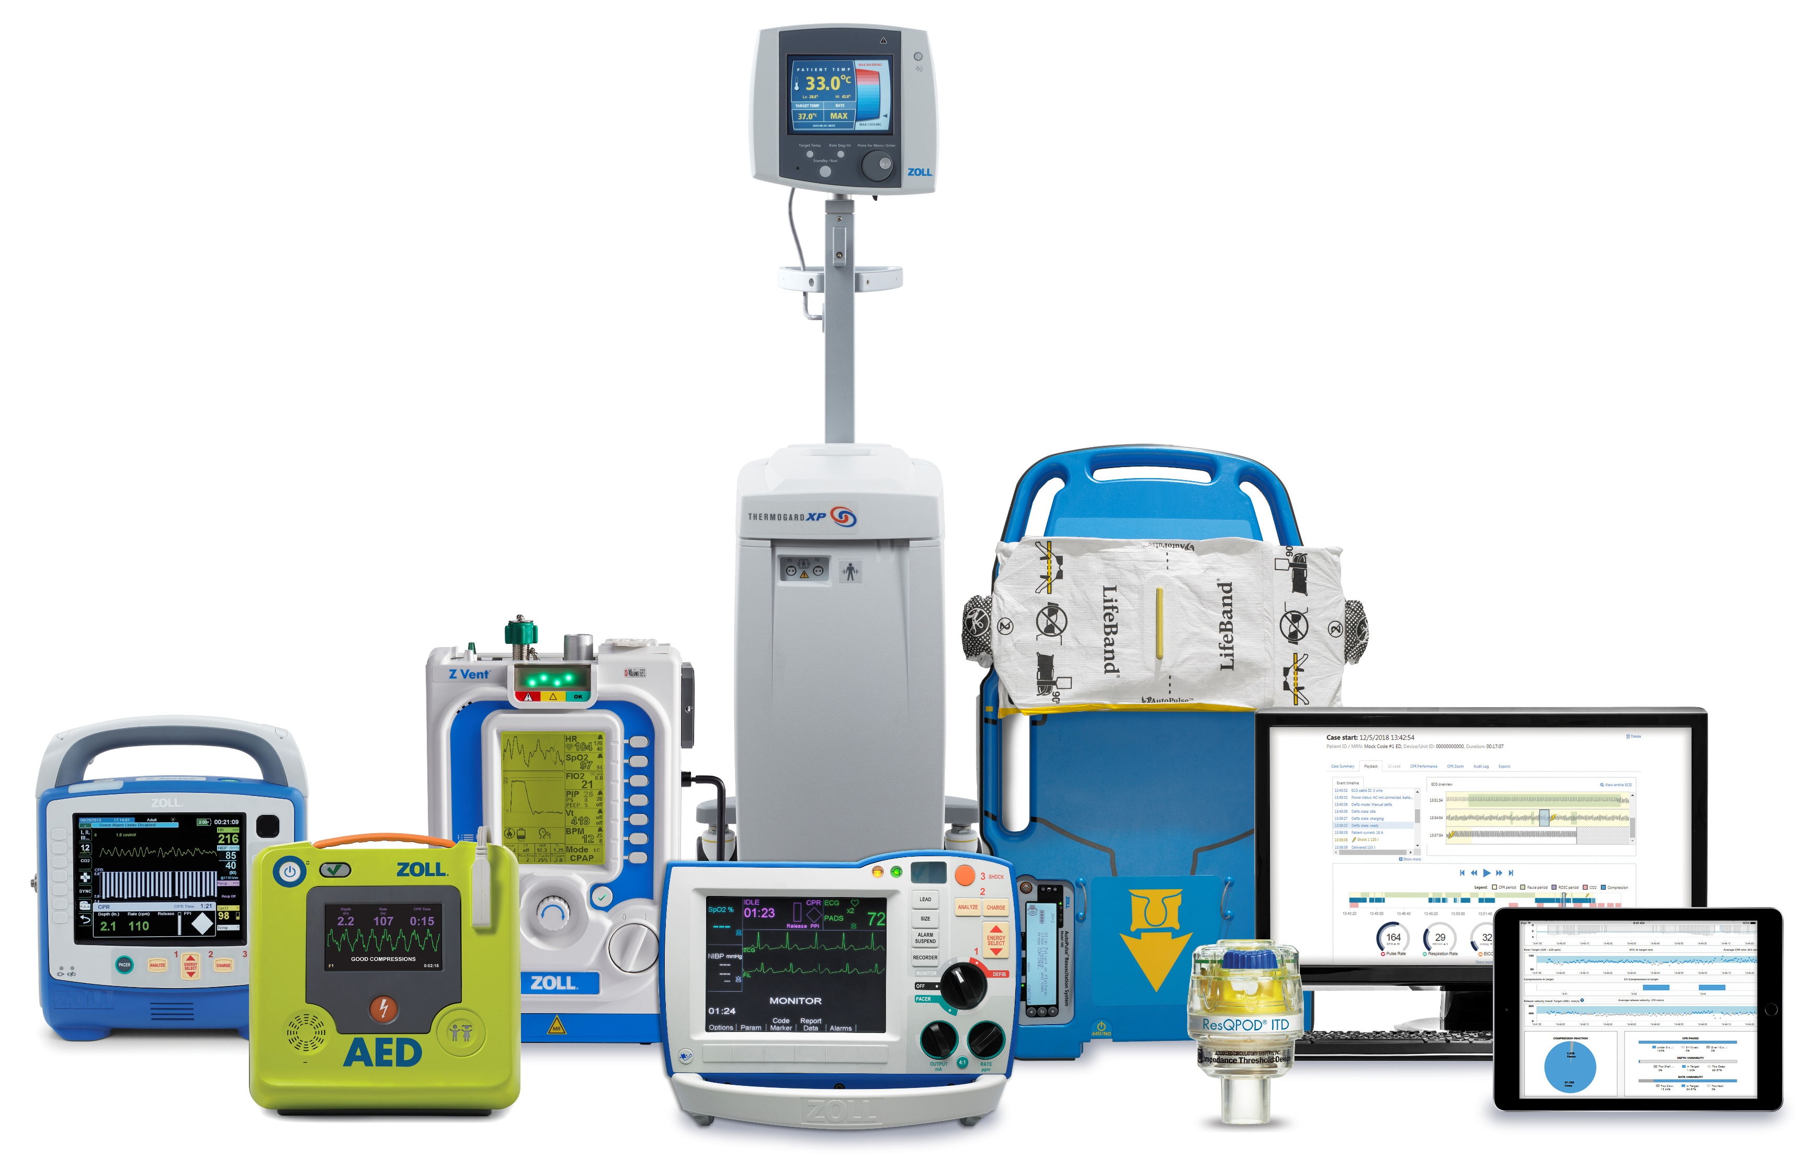
About ZOLL
Medical device company with a global footprint for emergency care, both in-hospital and for EMS.
HQ in Chelmsford, MA.
Resuscitation products: Defibrillators, ventilators, and AEDs.

Slide 4
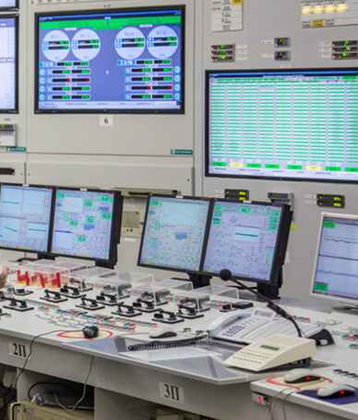
What is HFE?
Definition: Designing products to account for human limitations, both physical and cognitive.
Historically has its roots in high-risk industries:
Nuclear engineering
Aerospace engineering
Military applications
Human factors is now being integrated into:
Medical device industry
Consumer electronics/technology (ex: Apple)
Robotics
Automotive engineering

Slide 5
What is Usability Engineering?
USABILITY
HUMAN FACTORS
UX
Quantifying device performance with a focus in safety and clinical effectiveness
Measuring and understanding human performance
Subjective user feedback and product satisfaction
Notes:
I am sure that many of you are familiar with different terms like usability, human factors, or user experience, but the concept of usability engineering as its own department may still be new to some people so I think that it is worth defining so that others understand what it is that we do.
Usability - the extent to which a product can be used by specified users to achieve its intended use in a specified context of use
Human Factors – a scientific discipline concerning the understanding of interactions among humans and other elements of a system (technology, equipment, environment, etc…)
User Experience – describes the “feeling” of using a product, overall ease of use and satisfaction with the product.
All three of these disciplines include different measurements of the device, the user’s capabilities, and the subjective feedback of the user.
Usability Engineering is combination of all three of these principles and that puts the users of the device at the center of the development process.

Slide 6
What is Usability Engineering?
USABILITY
HUMAN FACTORS
UX
Describes ability to use product
Understanding of safety and effectiveness
Includes measurements of device performance
Scientific discipline
Understanding human interactions with systems
Includes measurements of user performance
Describes “feeling” of using product
Understanding ease and satisfaction of product use
Includes measurements of subjective feedback
Notes:
I am sure that many of you are familiar with different terms like usability, human factors, or user experience, but the concept of usability engineering as its own department may still be new to some people so I think that it is worth defining so that others understand what it is that we do.
Usability - the extent to which a product can be used by specified users to achieve its intended use in a specified context of use
Human Factors – a scientific discipline concerning the understanding of interactions among humans and other elements of a system (technology, equipment, environment, etc…)
User Experience – describes the “feeling” of using a product, overall ease of use and satisfaction with the product.
All three of these disciplines include different measurements of the device, the user’s capabilities, and the subjective feedback of the user.
Usability Engineering is combination of all three of these principles and that puts the users of the device at the center of the development process.

Slide 7
Relevant Standards
HFE in the medical device industry is driven by a specific set of standards:
Standard Number | Title
ANSI/AAMI HE75 | Human Factors Engineering: Design of Medical Devices
ISO/IEC 62366-1 | Medical devices – Part 1: Application of usability engineering to medical devices
ISO/IEC 60601-1-6 | Medical electrical equipment - Part 1-6: General requirements for basic safety and essential performance - Collateral standard: Usability
ANSI/AAMI/ISO 14971 | Medical devices — Application of risk management to medical devices
FDA Guidance (2016) | Guidance for Industry and Food and Drug Administration Staff: Applying Human Factors and Usability Engineering to Medical Devices
FDA Guidance (2022) | Content of Human Factors Information in Medical Device Marketing Submissions
Notes:
Because we’re standards driven, whether we perform human performance testing is determined by the severity of a

Slide 8
Hazard Analysis
How do we identify and document different types of

Slide 9



Definitions (per ISO 14971)
A hazard is a potential source of harm.
A hazardous situation may arise when a foreseeable sequence of events exposes people, property or environment to one or more hazards
Harm is Injury or damage to people, property, or the environment.

Slide 10
Hazards
Physical
Slippery floors
Chemical
Strong cleaning agents
Biological
Bacteria
Viruses
Human Factors
Poor posture
Heavy objects
Flammable materials
Mold
Repetitive strain
Long shifts
Can be classified into categories:
…and more!

Slide 11

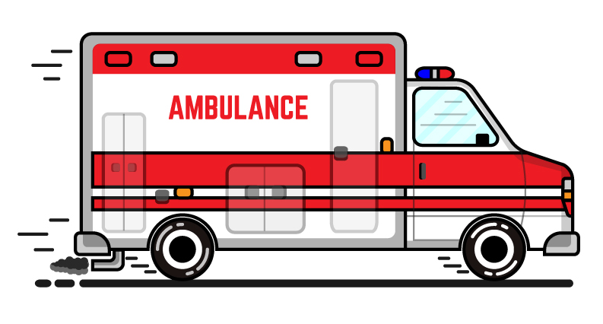
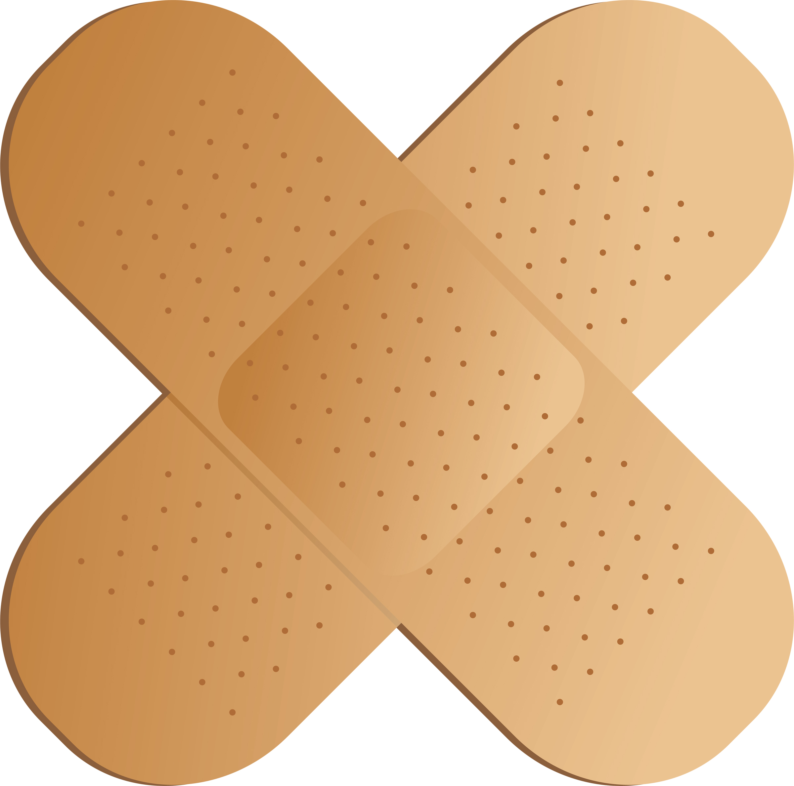
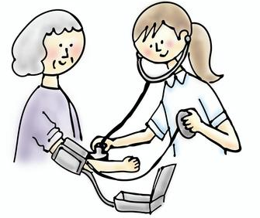
Quantifying Risk – Severity & Probability
Risk is the likelihood of harm that occurs from any given hazard. Calculated through a matrix based on severity and probability.
Severity – How serious the consequence is. Often determined by clinicians/scientists.
Severity Level | Numeric Value | Definition
Catastrophic | 4 | Life threatening injury, illness or death to the patient, operator or bystander
Critical | 3 | Non-life threatening but significant physical injury to patient, operator or bystander that requires repeated professional medical treatments.
Marginal | 2 | Minor physical injury to the patient, user or bystander requiring self-medication or a single professional medical treatment.
Negligible | 1 | Absence of injury / discomfort or temporary, minor injury / discomfort to patient, user or bystander that does not require treatment.

Slide 12
Quantifying Risk – Severity & Probability
Risk is the likelihood of harm that occurs from any given hazard. Calculated through a matrix based on severity and probability.
Probability – The likelihood of the hazardous situation occurring. Typically determined by engineering team.
Probability | Numeric Value | Definition
Frequent | 4 | 1 in 100
Probable | 3 | 1 in 1,000
Remote | 2 | 1 in 100,000
Improbable | 1 | 1 in 1,000,000

Slide 13
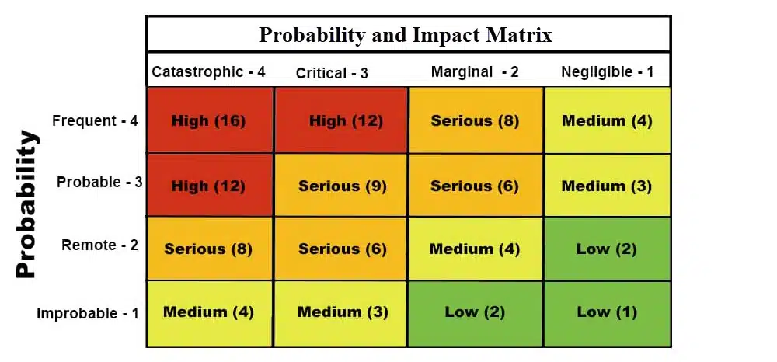
Quantifying Risk – Severity & Probability
Risk is the likelihood of harm that occurs from any given hazard. Calculated through a matrix based on severity and probability.

Slide 14
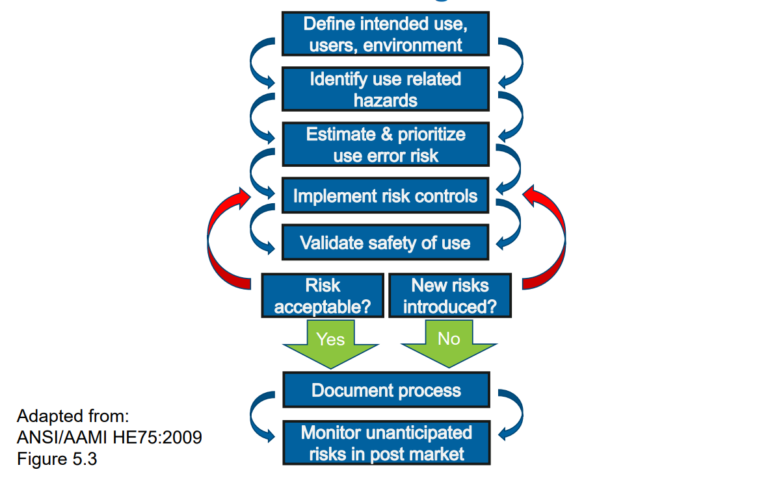
The HF component of Risk Management

Slide 15
How do we identify use-related hazards?
Task Analysis
Break down the user interactions, step by step
DFMEA
Assess materials and parts specs for limitations and modes of failure.
Hazard Analysis
Captures the harm, probability, severity, and mitigations.

Slide 16
Example Case
Electrical engineering team selects a battery pack for the design
Battery manufacturer specs are assessed as part of the DFMEA process → Battery cells have a specific temperature operating range
Temperature range is captured in a task analysis → “User leaves device in direct sunlight”
Mitigations are determined based on this. Ex: Labeling about temperature range, warning to keep indoors.

Slide 17





Tools for uncovering use-related risk
TASK ANALYSIS
AWARENESS
UNDERSTANDING
CORRECT ACTION
PERCEPTION
COGNITION
ACTION
PCA
ANALYSIS
UNAWARENESS
MISUNDERSTANDING
INCORRECT ACTION
USE ERRORS

Slide 18
Example Task Analysis
 | Perception Cognition Action |  |  | Risk Information
Task Sub-step | Perception | Cognition | Action | Potential Use Error | Potential Cause | Patient/User Harm | Severity | Critical Task (Y/N) | Risk Mitigations | Evaluation Method
Clean the device and accessories after patient use. | User sees dirty AED. | User understands that the AED must be cleaned after use. | User wipes down AED. | User does not properly clean the device. | Patient blood or vomit is not cleaned off the device | Bio-contamination leads to patient or user infection | 3 | Y | Cleaning procedure included in the op guide as required by IEC 60601-1. Labeling per safety standards is the best recognized response to this hazard.

Slide 19
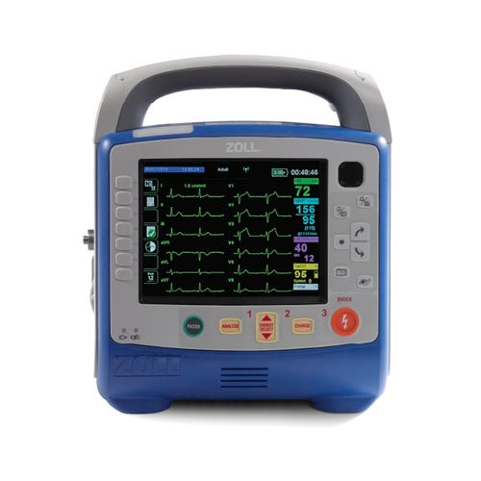
Task Analysis
Task | Subtask | Use Error | Cause
Deliver a shock | Select energy level | User selects incorrect energy level | User does not understand that default energy level is based on patient mode
 |  |  | User presses the energy select button too few / too many times
 |  | User is unable to set desired energy level | User cannot locate energy selection controls / confirmation
 | Charge device | … | …
 | Deliver shock | … | …
Harm | Severity | Risk Control(s)
Too much / too little energy delivered | 3 or 4 | Usability Validation Design controls Energy select button/display Patient mode display
Failure to convert defibrillation | 2 or 3 | Design controls Charge/Energy Select buttons Operator’s Guide Usability testing?
Notes:
We look at all of the things that can go wrong, look at it in PCA perspective
Make sure to note/define CRITICAL TASK

Slide 20

Contact Info
Alex Ngan, RPI ’21
Usability Engineer II
Email: Alex.Ngan@ZOLL.com
LinkedIn:

Slide 21
Any Questions?

Slide 22
Other Definitions
FMEA – “Failure Mode and Effects Analysis”
May also be known as DFMEA = “Design Failure Mode and Effects Analysis”
Use error –
Human error – deviance from appropriate behavior

Slide 23
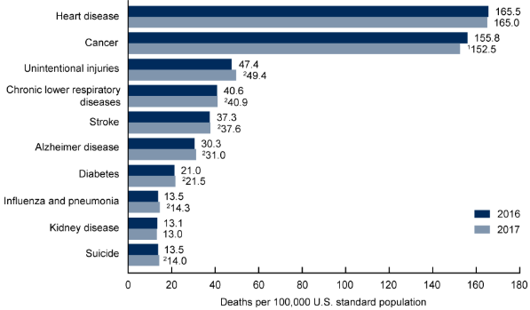
HFE in Medical Devices
According to a study at Johns Hopkins (2016), medical errors are:
The 3rd leading cause of death in the U.S.
More than 250,000 people die per year from medical errors
Source: National Vital Statistics System

Slide 24
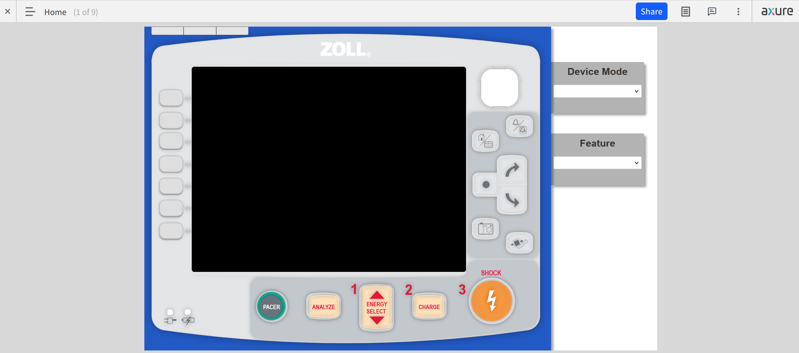
Defib/Monitor – Remote Formative
Challenge: Needed user feedback to gauge
EMS and Emergency Dept. personnel have limited availability
Built a prototype in Axure that could be shared with a participant remotely

Slide 25
About Me
2013-2017 Bronx Science
2017 Started at RPI
2021 to present Usability Engineer at ZOLL
2020 Graduated RPI
2019 JnJ DePuy Synthes

Slide 26
Overview – By the Numbers
6 |  | I support six major product families
18+ |  | …which contain more than eighteen product lines/project teams
4 |  | …across six ZOLL offices in four different time zones

Slide 27
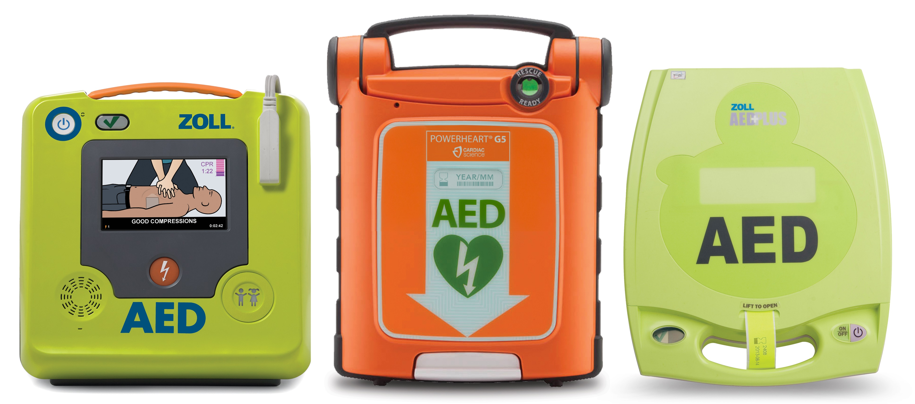
Public Safety
AED 3, AED Plus, AED Pro,

Slide 28
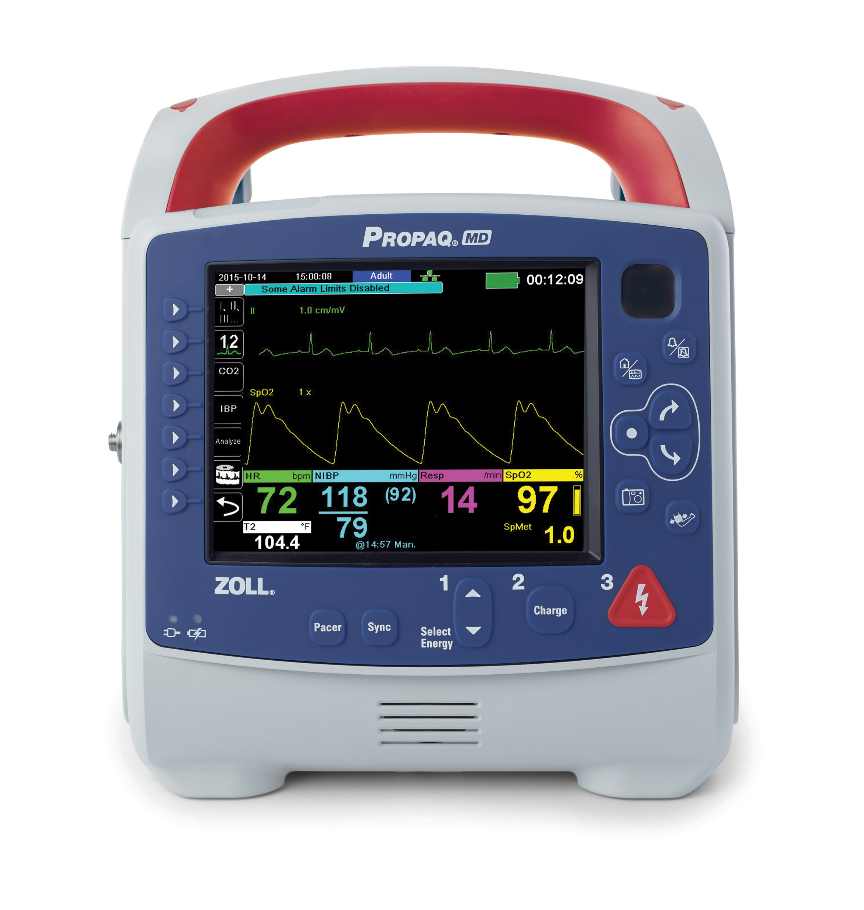
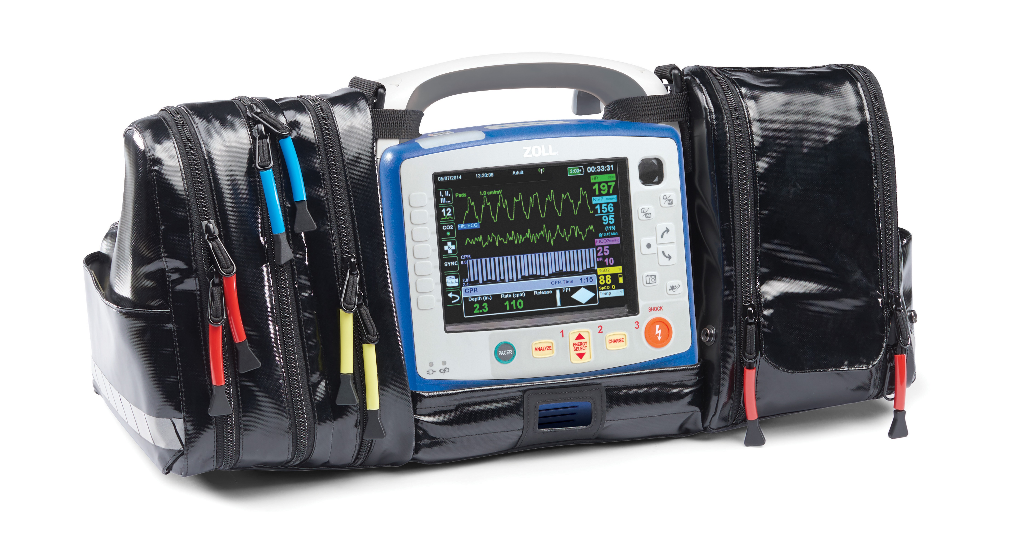
Professional Defibrillators/Monitors
Class III medical devices used by hospital and EMS providers.

Slide 29
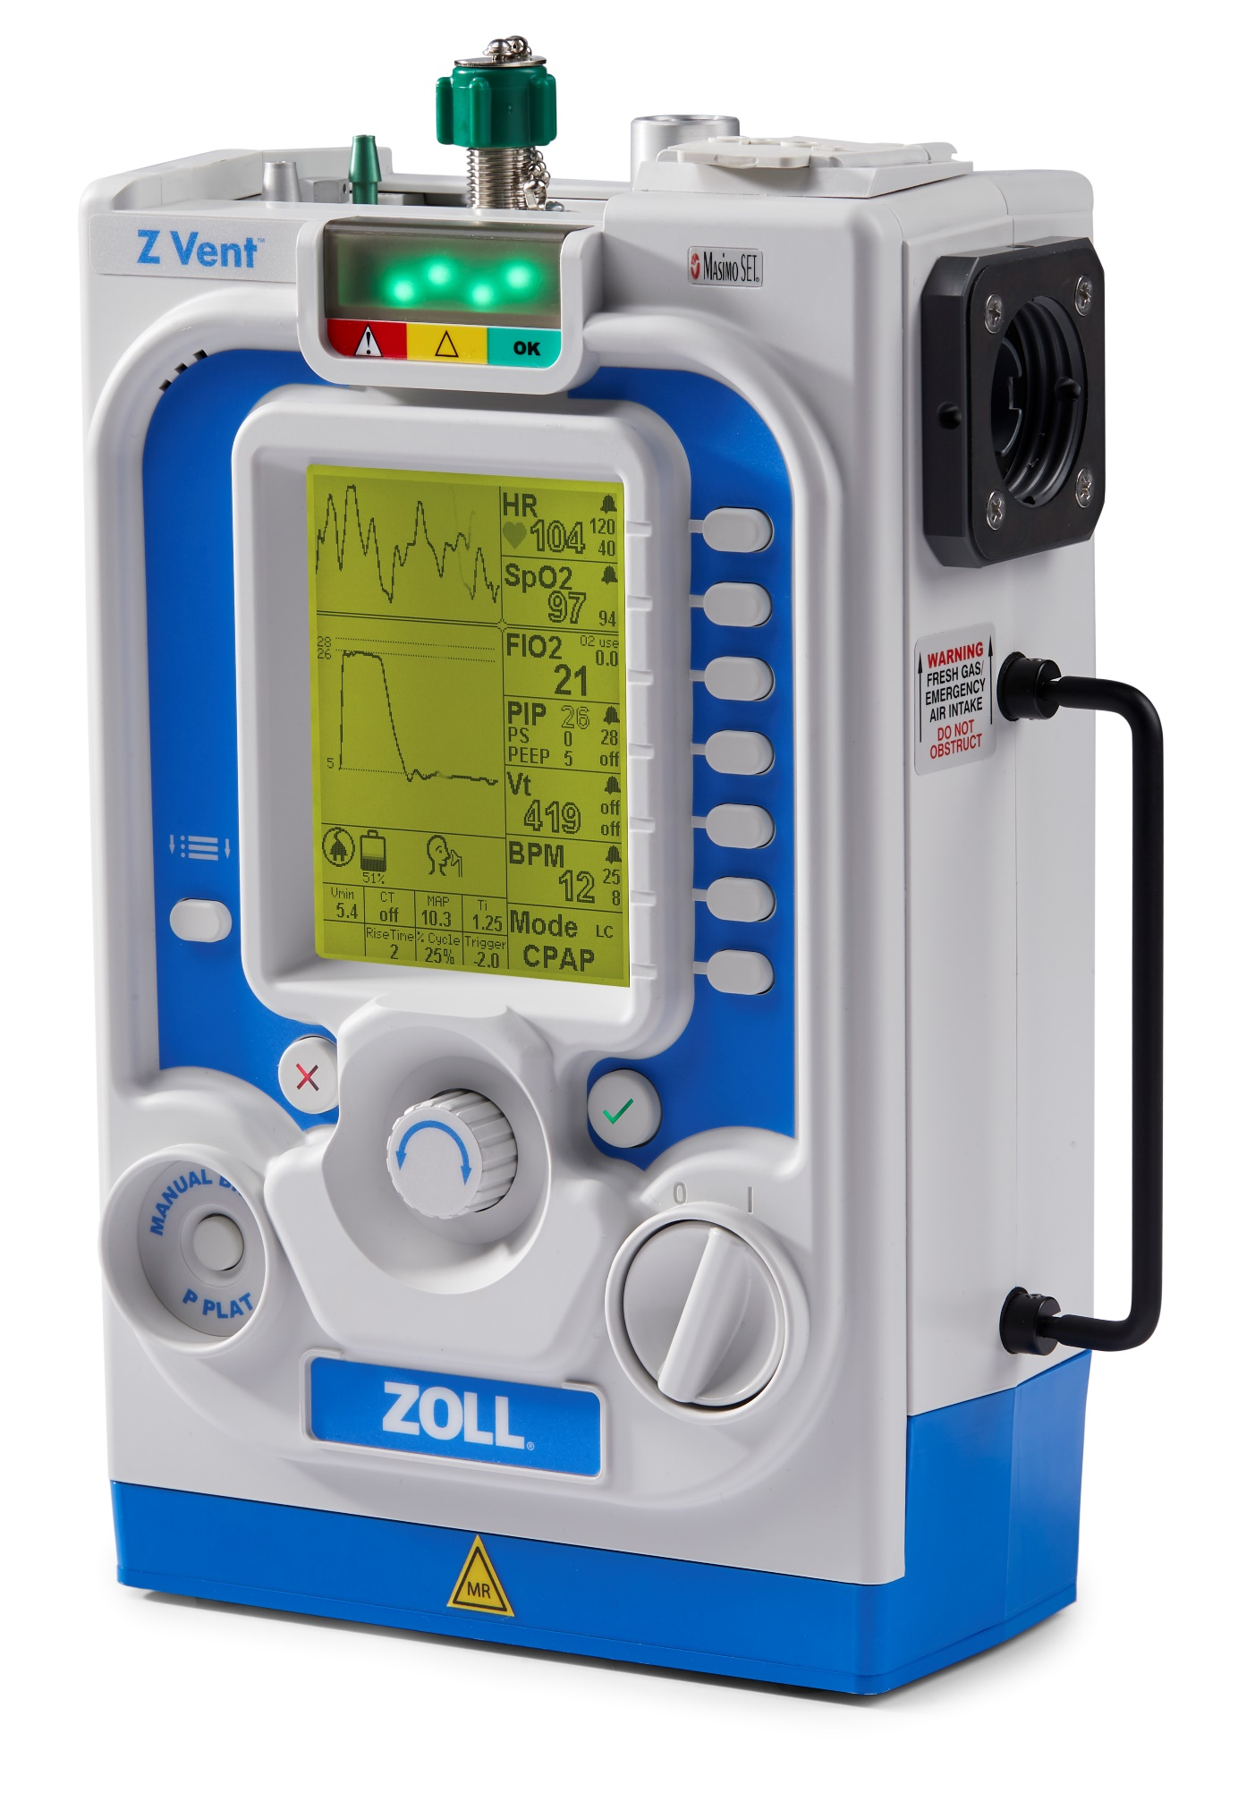
731 Series Ventilators
Family of lightweight transport ventilators for commercial and military use.
Supports pediatric and adult patients.

Slide 30
Advanced Development

Slide 31
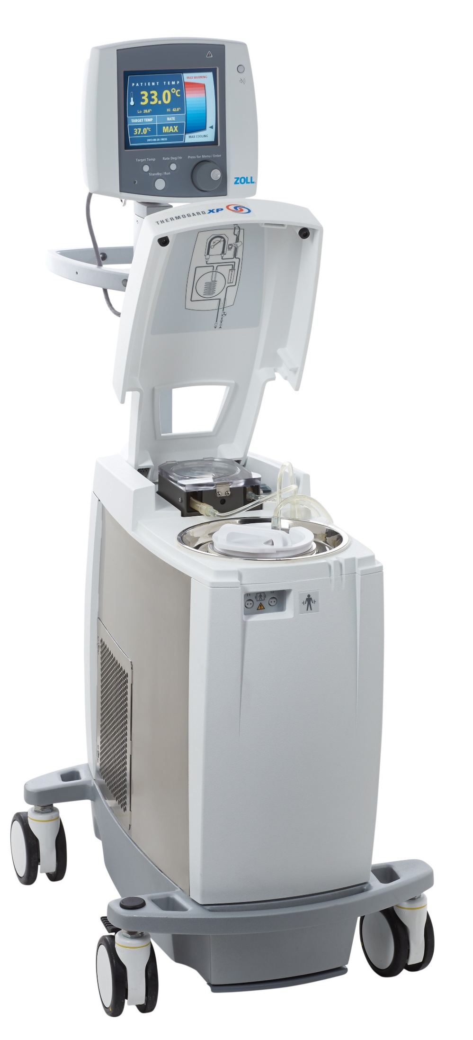
Temperature Management

Slide 32
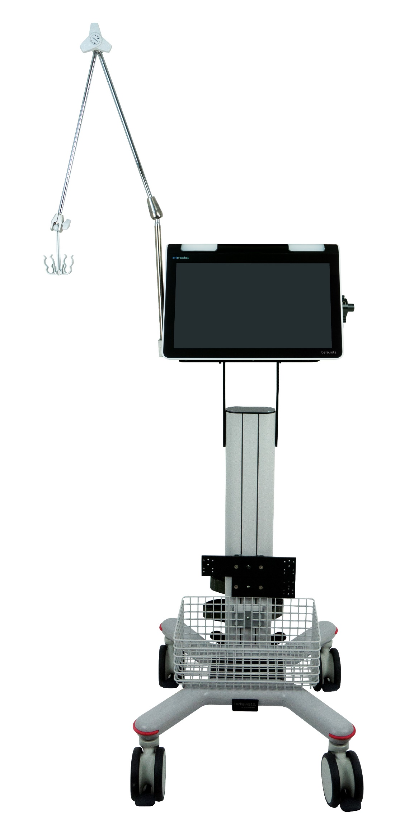
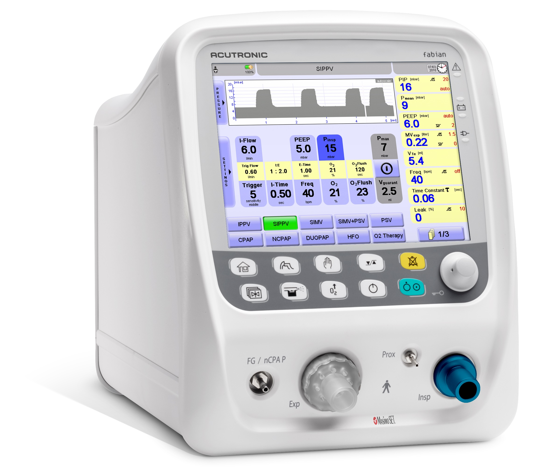
Vyaire Ventilators
The fabian and bellavista ventilator families are both in-hospital ventilators for patients ranging from neonates to adults.

